Slide 1
Wave Mechanical Model

Slide 2
Bohr Model- What Bohr got right
Orbitals – highly probable location around the nucleus where electrons can be found
Energy levels are quantized (only certain discrete energy levels are allowed)
Ground state – The lowest energy state of an electron in an atom
Excited stated – Energy state an electron travels to when energy is added in the form of heat or light.

Slide 3
Schrodinger’s Modifications
Schrodinger modified Bohr’s model of the atom once he proposed that electrons exhibit particle and wave-like behavior just like light.
Schrodinger used mathematics and this idea to predict electrons exact location around the nucleus. (Orbitals)
Orbitals do not equal the circular orbits that Bohr predicted.

Slide 4
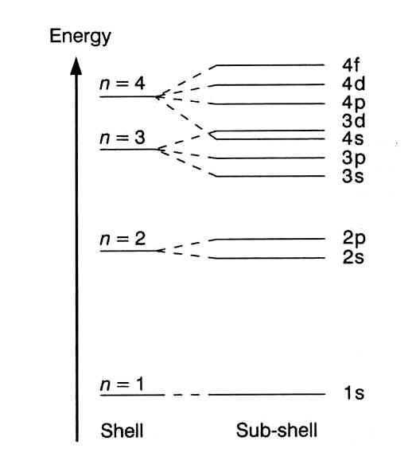
The discrete energy levels that hydrogen has are shown here.
These levels are called principle energy levels and each is labeled with an integer (ex: n=1, n=2,…)
Each level divided into sublevels.
Notice that as the principle energy level increases by 1 so does the number of sublevels

Slide 5
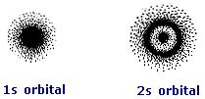
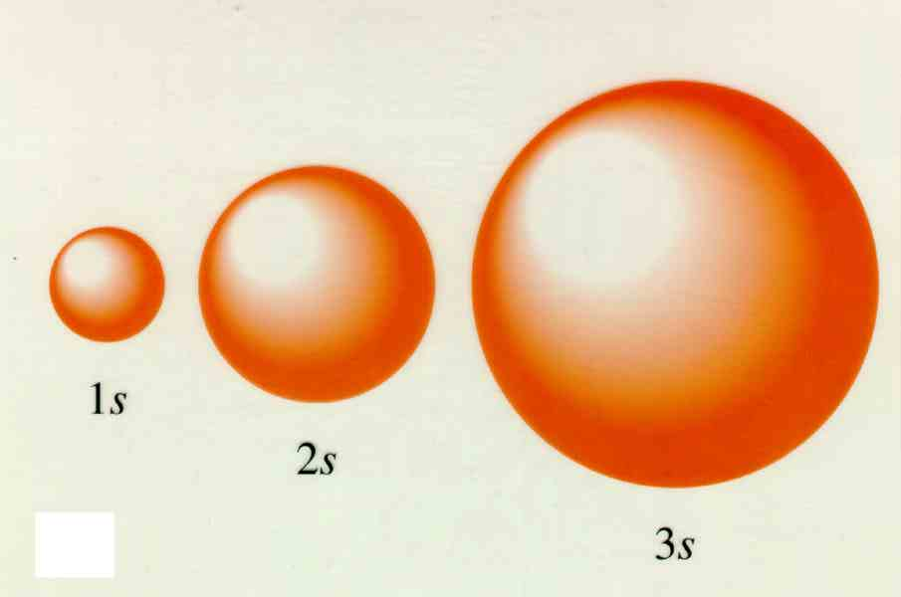
The 1s and 2s Orbital

Slide 6
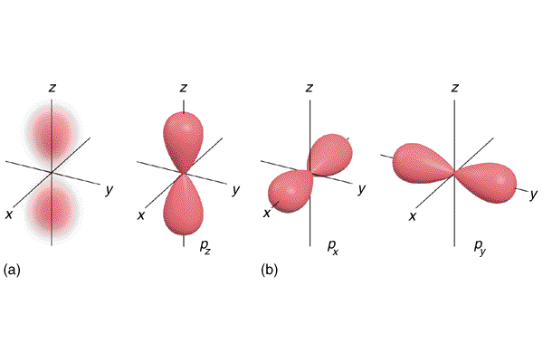
The 2p Orbitals

Slide 7
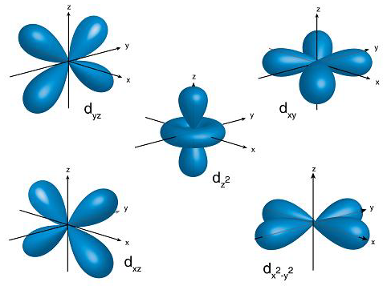
The 3d Orbitals

Slide 8
The 4f Orbitals

Slide 9
Orbital Labels
The number tells the principle energy level.(n=1,n=2,n=3, n=4, n=5, n=6, n=7)
The letter tells the shape (s = sphere, p = 2-lobes, d= 4 lobes, f=8 lobes)
The x, y, or z subscript tells along which axis the different lobes lie (ex: the 2p_{x} orbital lies along the x-axis
Examples: 3p_{y}, 5s, 4d_{xy}, 5f_{xyz}

Slide 12
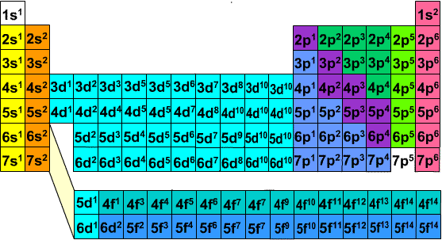

Slide 13
Electron Configuration
A way of representing the electron arrangement of an atom that expresses how many electrons the atom has and what orbitals those electrons are in.
The periodic table is your guide for electron configuration. The orbitals are filled in a specific order that corresponds to the order of the periodic table.
The electron configuration contains the principle energy level, the sublevel and the number of electrons in that sub level. Examples: 1s²2s²2p⁶, 1s²2s²2p⁶3s²3p⁶4s²3d³, 1s¹, 1s²2s²2p⁶3s¹

Slide 14
Electron Configuration
Write the Electron configuration for the following elements:
Aluminum-
Nickel –
Calcium-
Bromine-

Slide 15
Electron Configuration
Write the Electron configuration for the following elements:
Aluminum- 1s²2s²2p⁶3s²3p¹
Nickel – 1s²2s²2p⁶3s²3p⁶4s²3d⁸
Calcium- 1s²2s²2p⁶3s²3p⁶4s²
Bromine- 1s²2s²2p⁶3s²3p⁶4s²3d¹⁰4p⁵

Slide 16
Noble Gas Configuration
An abbreviated electron configuration which includes a noble gas and the electrons filling orbitals after the noble gas
Example: Aluminum can be written as [Ne]3s²3p¹ instead of writing out all the orbitals before Neon
Example: Bromine can be written as [Ar]4s²3d¹⁰4p⁵ instead of writing out all the orbitals before Argon

Slide 17
Noble Gas Configuration
Write the noble gas configuration for the following elements:
Ytterbium
Lanthium
Cesium
Phosphorus

Slide 18
Noble Gas Configuration
Write the noble gas configuration for the following elements:
Ytterbium – [Xe]6s²4f¹³
Lanthium – [Xe]6s²5d¹
Cesium – [Xe]6s¹
Phosphorus – [Ne]3s²3p³

Slide 19
Aufbau Principle
States that electrons occupy the lowest energy orbital that can receive it.
Example: A 2s orbital will fill with electrons before any electrons occupy a 2p orbital
Remember the periodic table tells you the order in which orbitals will fill

Slide 20
Hund’s Rule
States that orbitals of equal energy are occupied by one electron before any is occupied by a second electron.
Example: The 2p_{x} orbital cannot have two electrons before both the 2p_{y} orbital and the 2p_{z} orbital each have one electron.
Think of Hund’s rule like the monopoly building rule. You cannot have a property with two houses until each property has one house.

Slide 21
Pauli Exclusion Principle
States that an orbital can hold a maximum of two electrons and those two electrons must have opposite signs.
S orbitals can each hold 2 electrons total, P orbitals can hold a total of 6 because of the three different sublevels (2p_{x} holds 2, 2p_{y} holds 2, and 2p_{z} holds two), D orbitals hold a total of 10 because of five different sublevels, and F orbitals hold a total of 14 because of 7 different sublevels.

Slide 22
Orbital Filling Notation
A way to describe how each orbital will be filled with electrons for each specific element.
Similar to electron configuration but shows the two electrons with opposite spins in each orbital.
Example: Nitrogen

Slide 23
Orbital Filling Notation
Express the following elements in orbital filling notaion:
Magnesium
Potassium
Cobalt
Selenium

Slide 24
Quantum Numbers
Each Orbital is characterized by a series of quantum numbers.
The principal quantum number (n) has integral values. It is related to the size and the energy of the orbital. As n increases the orbital becomes larger and the orbital has a higher energy level.
The angular momentum quantum number (l) has an integral value from 0 to n-1. It is related to the shape of the orbital. When l=0 it is an s orbital, when l=1 it is a p orbital, when l=2 it is a d orbital, and when l=3 it is a f orbital.

Slide 25
Quantum Numbers
The magnetic quantum number (m) has integral values between l and –l including zero. It is related to the different orientations of the orbital in space relative to the other orbitals in the atom,
The spin quantum number (s) is representative of the Pauli Exclusion Principle. The values can either be spin up or spin down to represent the opposite spins the two electrons in an orbital must have. This number helps determine the total number of electrons that can be in an orbital.

Slide 26
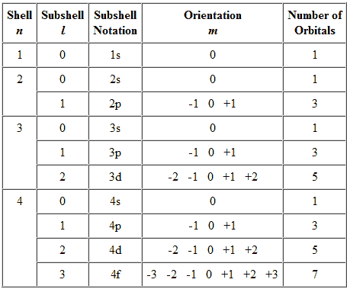
Quantum Numbers

