Slide 1
Test Review

Slide 2
Kinetic or Potential?
A McDouble

Slide 3
Kinetic or Potential?
Cheetos

Slide 4
Kinetic or Potential?
Throwing a paper ball

Slide 5
Kinetic or Potential?
A Waterfall

Slide 6
Endothermic or Exothermic
Positive q value

Slide 7
Endothermic or Exothermic
Negative ΔH

Slide 8
Endothermic or Exothermic
Heat taken in or heat absorbed

Slide 9
Endothermic or Exothermic
Energy written as a reactant

Slide 10
Endothermic or Exothermic
Sublimation

Slide 11
Endothermic or Exothermic
Freezing

Slide 12
Endothermic or Exothermic
Condensation

Slide 13
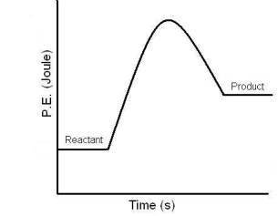
Endothermic or Exothermic

Slide 14
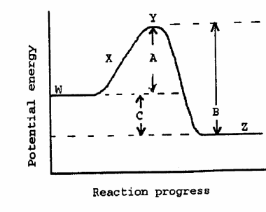
Identify the following
Activation Energy
Products
ΔH
Reactants

Slide 15
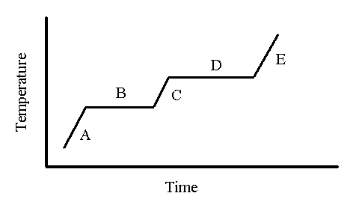
Identify the following
H_{v}
Solid + Liquid
Freezing Point
Use q = mcΔT
C→B Exo or Endo

Slide 16
Temperature/ Energy Conversions
1 cal = 4.184 J K=°C + 273 °C=(°F-32)x 5/9
53°F= ______°C

Slide 17
Temperature/ Energy Conversions
1 cal = 4.184 J K=°C + 273 °C=(°F-32)x 5/9
43 cal= ______J

Slide 18
Temperature/ Energy Conversions
1 cal = 4.184 J K=°C + 273 °C=(°F-32)x 5/9
75.0°C= ______°F

Slide 19
Temperature/ Energy Conversions
1 cal = 4.184 J K=°C + 273 °C=(°F-32)x 5/9
72kcal= ______J

Slide 20
Temperature/ Energy Conversions
1 cal = 4.184 J K=°C + 273 °C=(°F-32)x 5/9
41.0°C= ______K

Slide 21
Temperature/ Energy Conversions
1 cal = 4.184 J K=°C + 273 °C=(°F-32)x 5/9
89.4 kJ= ______kcal

Slide 22
Calculations
Calculate the amount of energy required to melt 83.6 grams of ice at 0 ̊C.

Slide 23
Calculations
An unknown metal with a mass of 150 grams is heated from 38.4 ̊C to 70.4 ̊C when 619.2 J of energy is added. What is the specific heat capacity of the substance?

Slide 24
Calculations
A piece of copper with a mass of 256.8 grams was heated to 135.79 ̊C and quickly immersed in 100.0 grams of water that was at a temperature of 22 ̊C. The water and copper came to a final temperature of 43.79 ̊C. What is the specific heat of copper?

Slide 25
Calculations
Calculate the energy change when 39.2 grams of water is heated from -12 °C to 72 °C

Slide 26
Calculations
A 29.4 gram sample of aluminum is heated to 135.0 ̊C and dropped into 48.34 grams of water, initially at 22.0 ̊C. The final temperature of both the water and the aluminum is 35.2 ̊C. Calculate the specific heat capacity of aluminum.

Slide 27
Calculations
A 94.3 gram sample of water at 32° C absorbs 349 J of heat. What is the final temperature of the water sample?

Slide 28
Calculations
Calculate the energy change when 1.2 grams of water is cooled from 130 °C to 22°C.

